Slide 1

Energy & CO2 Emissions
GitHub
Eliran Giar & Shon Malinski

Slide 2
Our research
Carbon dioxide (CO2): Carbon dioxide is the primary greenhouse gas, mainly come from burning organic materials: coal, oil, gas, wood, and solid waste.
Research questions:
Is there correlation between renewable energy to CO2 Emission?

Slide 3
Data sources
Data retrieve from Statistical Review of World Energy from BP
It’s an excel format with sheet 77 sheet contains fossil and non fossil dataset

Slide 4
Dataframes
Here we only create 3 dataframes;
Energy Consumption
Carbon Dioxide Emissions
Renewable Consumption
And breaking down these 3 datasets into country wise dataframe.

Slide 5
Data Cleaning and Formatting
Dealing with missing values
Dropping rows with too many missing values.
Selecting rows and columns
Many rows and columns contained unnecessary values, so we cleaning it by using iloc methods.
Get rid of unnecessary rows
The countries columns contain regions, and non country name, so this have to be deleted.
Formatting new dataframe
Transpose the dataset and using year as an index

Slide 6
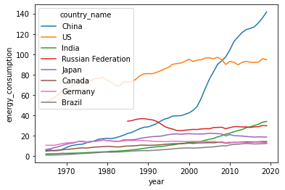
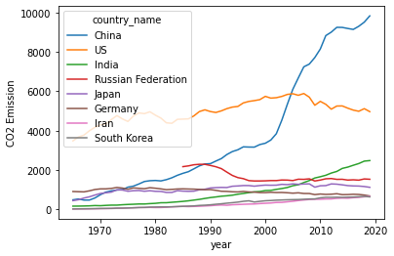
EDA & VIsualization
China was by far the biggest driver of energy, accounting for more than three quarters of net global growth. India were the next largest contributors to growth, while the US and Germany posted the largest declines.

Slide 7
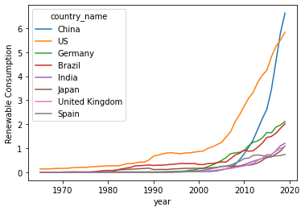
Top 8 countries with the highest renewable energy
Renewable energy (including biofuels) posted a record increase in consumption in energy since 2005. This was also the largest increment for any source of energy in 2019. China’s use of renewables grew by more than any other country.

Slide 8
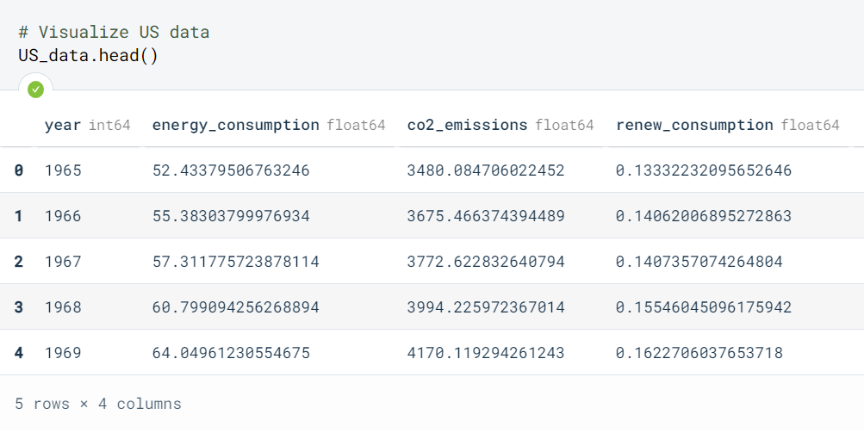
Exploring & Visualizing the Country Data
Exploring & Visualizing the Country Data are made for better understanding about the energy sector in a given country.
First we create dataframe that takes 1 feature (year) and takes values of three feature (Energy Consumption, Carbon Dioxide Emissions Renewable consumption) from respective dataframes.
Here are the example of US Energy >>

Slide 9
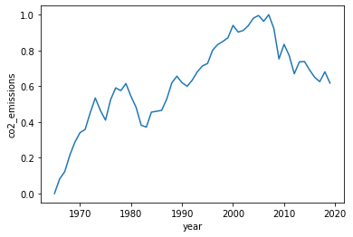
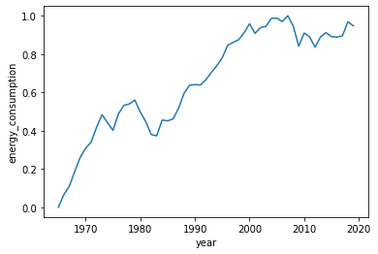
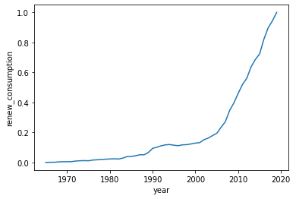
US Energy Data Visualization
From the data visualization below we can see that energy consumption and co2 emission are highly correlated, but co2 emission keep decreasing and slightly negative correlation with the renewable energy.

Slide 10
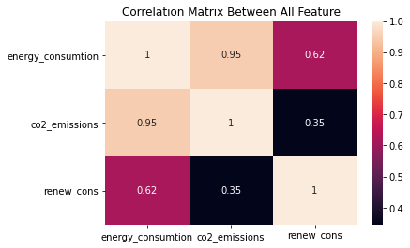
Correlation Between Features
A correlation matrix is a tabular data representing the ‘correlations’ between pairs of variables in a given data. This image shows that correlation between energy consumption and co2 emission are highly positive with score of 95% but correlation between renewable energy and co2 emission are very low about 35%.

Slide 11
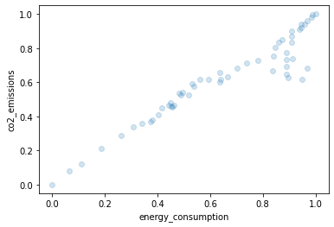
energy consumption and co2 emission
From this image we can clearly see that energy consumption and co2 emission has positive correlation

Slide 12
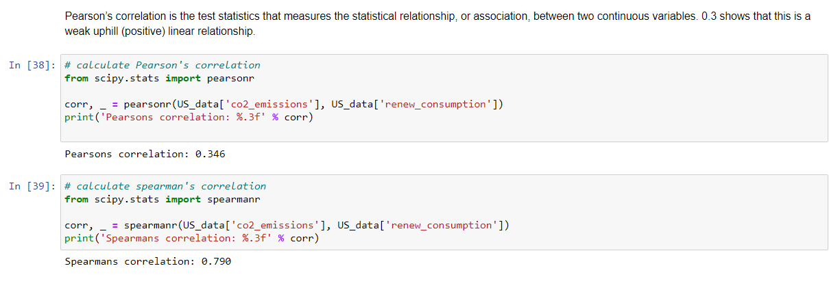
Pearson correlation & Spearmans correlation
Each one of them had a
different way to calculate
the correlation and as
we can see spearmans
correlation show our
idea better then pearson.

Slide 13
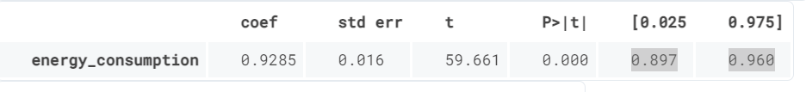
Linear regression using Statsmodels on Energy Data
Statsmodels is “a Python module that provides classes and functions for the estimation of many different statistical models, as well as for conducting statistical tests, and statistical data exploration.” (from the documentation).
The energy_consumption has statistically significant p-value; there is a 95% confidence intervals for the energy_consumption (meaning we predict at a 95% percent confidence that the value of energy_consumption is between 0.897 to 0.960).

Slide 14
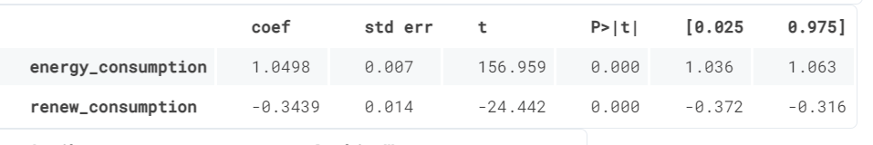
We can see here that this model has a much higher R-squared value 0.999, meaning that this model explains 99.9% of the variance in our dependent variable. Everytime we add variables to a regression model, R² will be higher, but this number shows almost a perfect number of R². We can see that both "energy_consumption" and "renew_consumption" are statistically significant in predicting (or estimating) the median of co2 emissions. So, combination between "energy_consumption" and "renew_consumption" are giving high impact on reducing the co2 emissions.

